Slide 1
Turing – Take home challenge
Build a simple web application where users can post and view messages

Slide 2
Front-End (React)
Create a simple and clean UI using React
Manage the application’s state effectively
Integrate with the backend.
Ensure the application is responsive and aesthetically pleasing

Slide 3
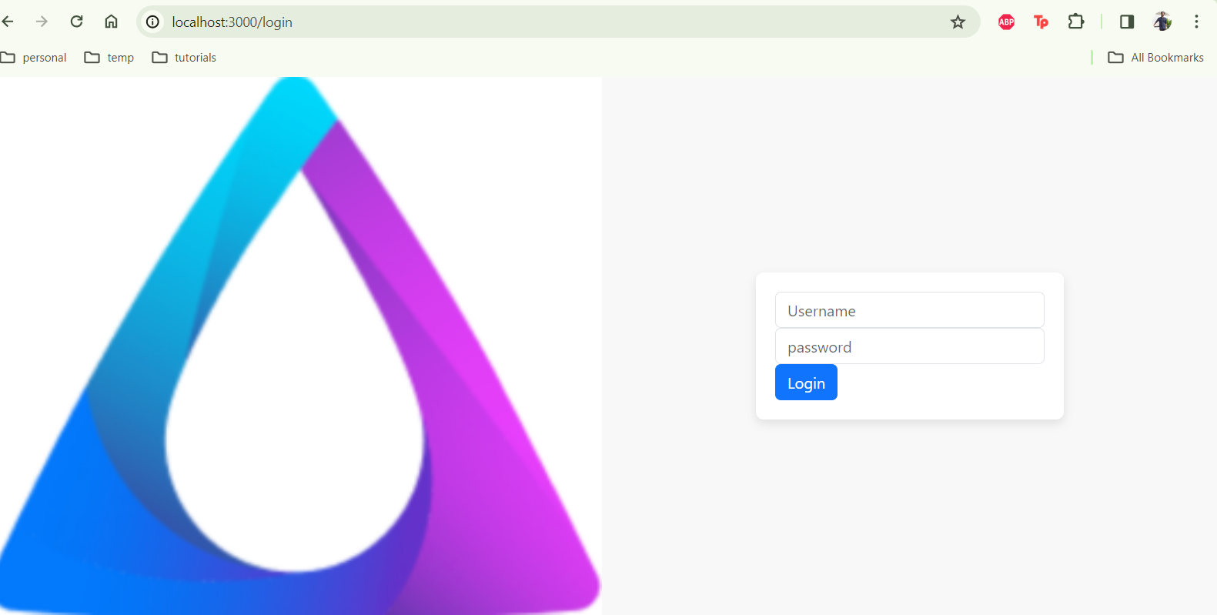
Create a simple and clean UI using React

Slide 4
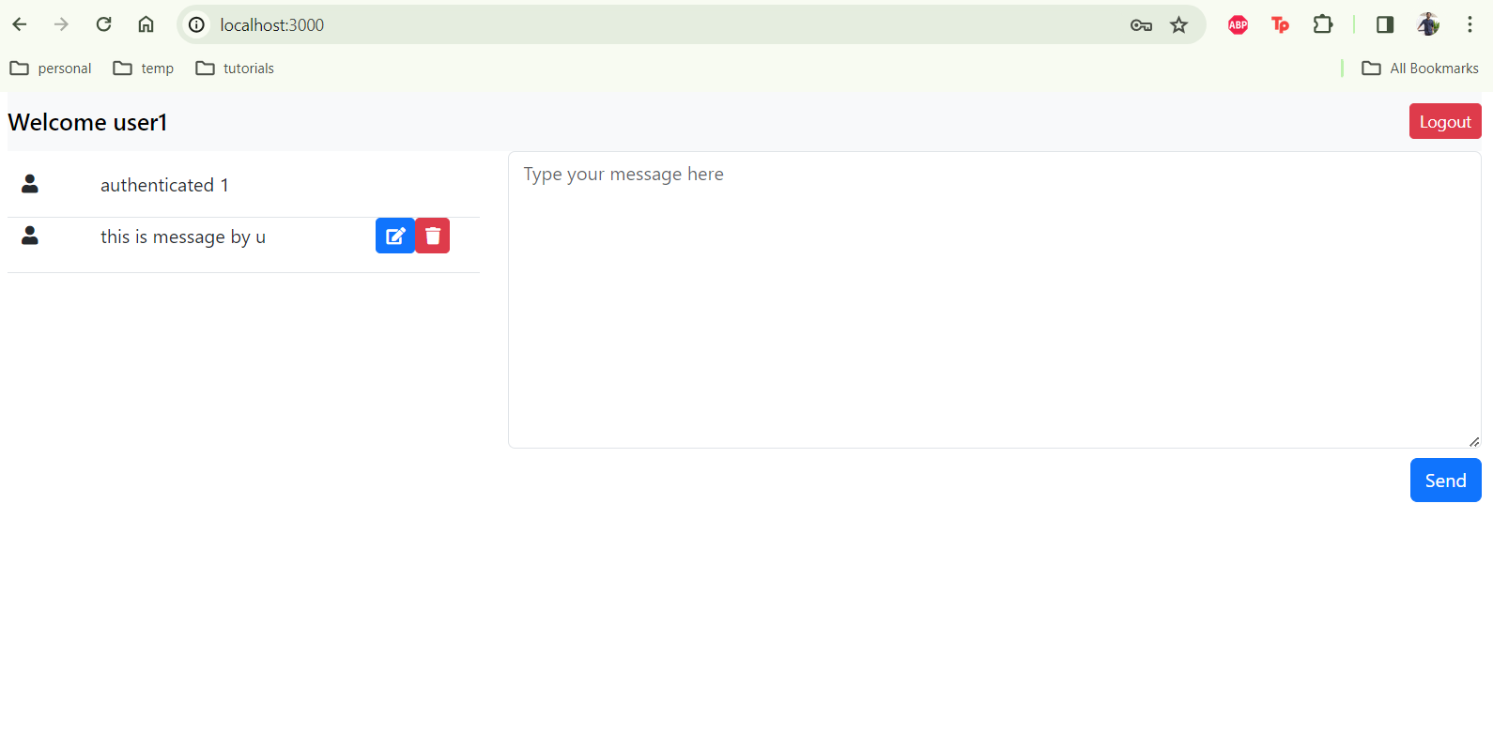

Create a simple and clean UI using React

Slide 5
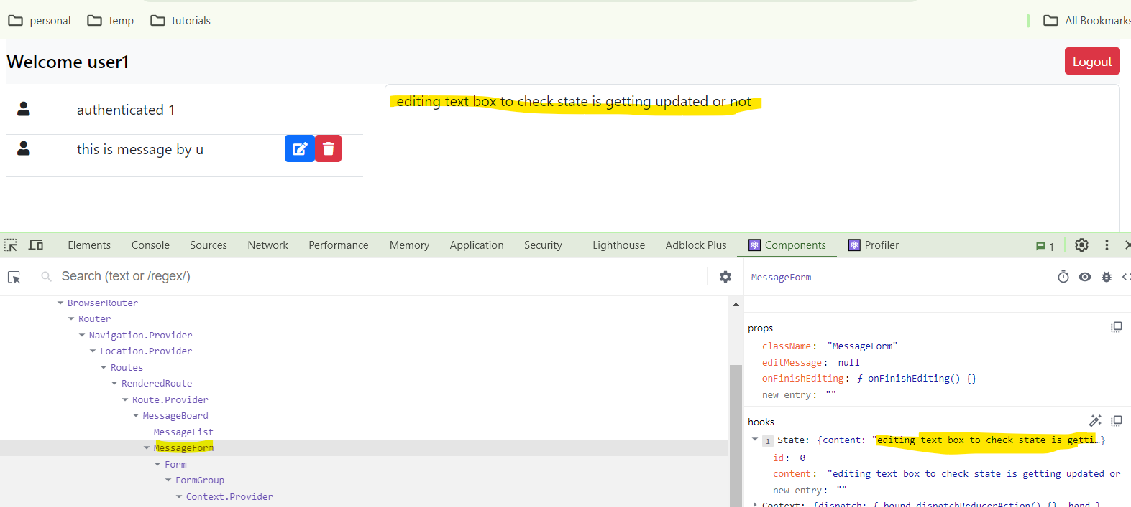
Manage the application’s state effectively
Use local state management for form inputs.

Slide 6
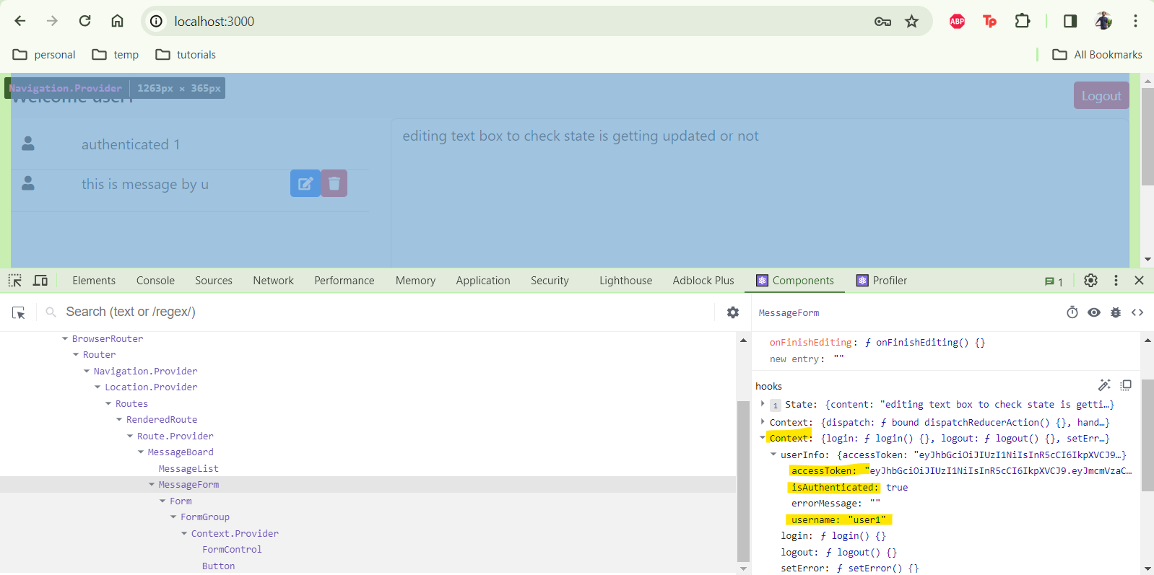
Manage the application’s state effectively
Optionally, use Redux or Context API for more complex state management.

Slide 7
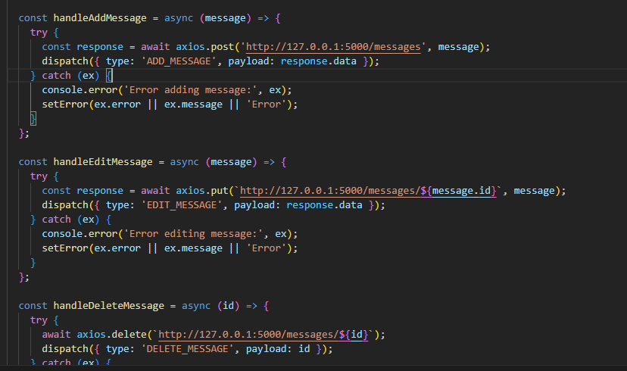
Integrate with the backend
Use Axios or Fetch API to send requests to the backend

Slide 8
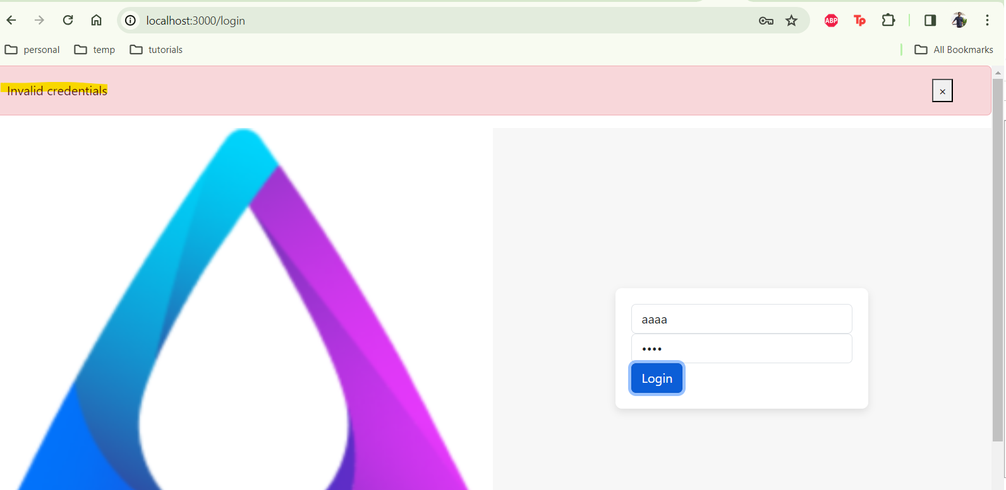
Integrate with the backend
Handle responses and errors gracefully

Slide 9
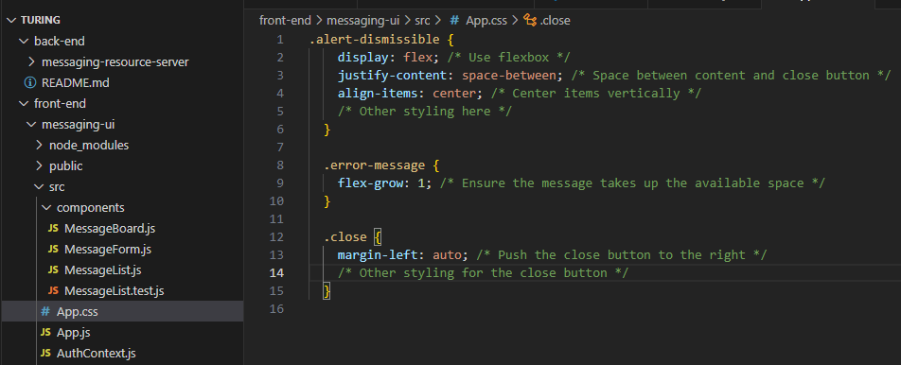
Ensure the application is responsive and aesthetically pleasing
Use CSS or a styling library like Styled-Components

Slide 10
Back-End (Python)
Create a RESTful API.
Implement data persistence.
Implement proper error handling.

Slide 11
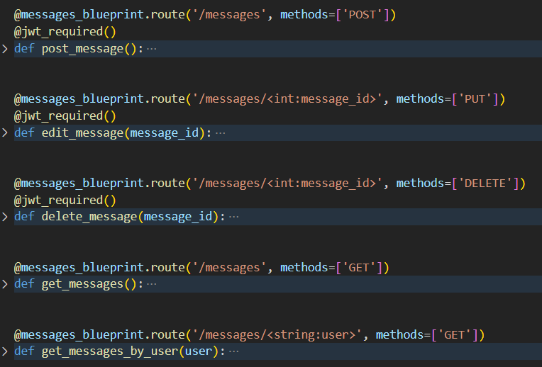
Create a RESTful API
Endpointsfor posting a message and retrieving all messages.

Slide 12
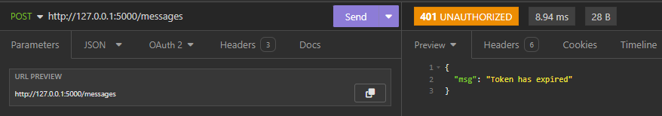
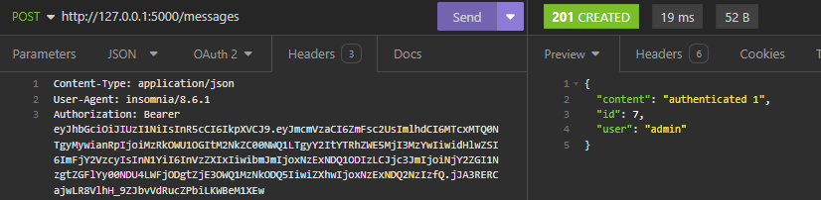
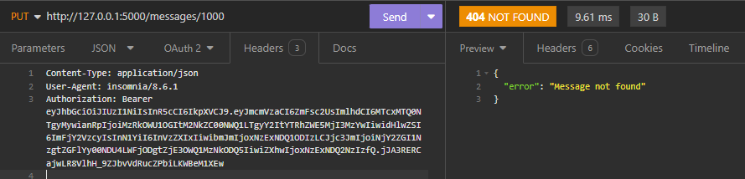
Create a RESTful API
Use appropriate HTTP methods and status codes.

Slide 13

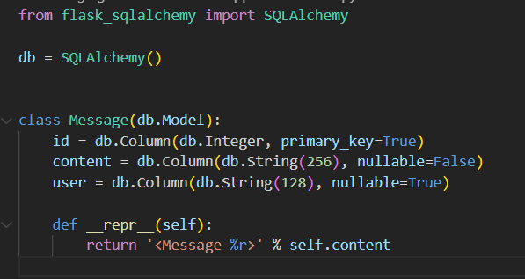
Implement data persistence
Use an in-memory store or a simple database like SQLite

Slide 14
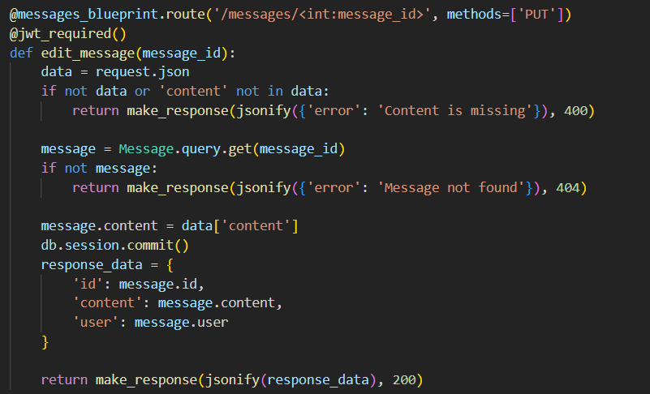
Implement proper error handling
Return meaningful error messages to the front-end.

Slide 15
Bonus Challenges
Implement user authentication.
Add the ability for users to edit or delete their messages.
Deploy the application to a cloud service.

Slide 16
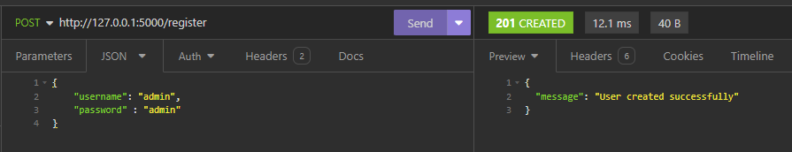
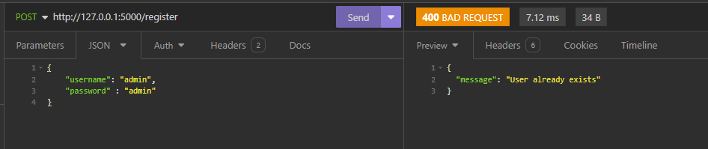
Bonus:Implement user authentication.
User can register on the backend server using end point - /register.

Slide 17
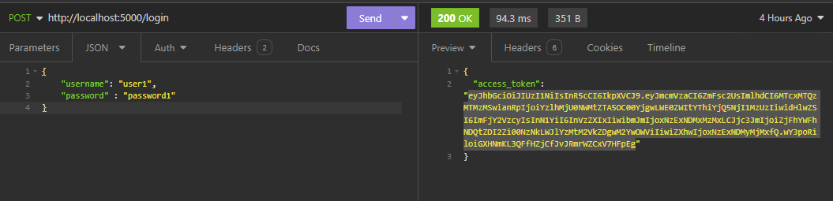
Bonus:Implement user authentication.
Registered users can get access token from the backend server using /login endpoint.
Upon validating username and password, an access token is provided. This is valid for 15 mins.

Slide 18
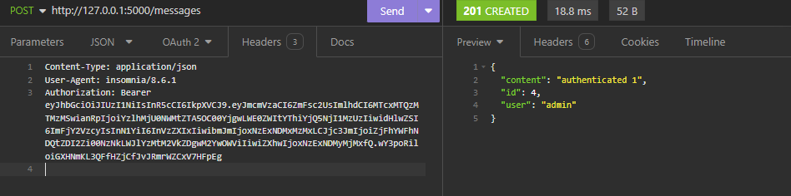
Bonus:Implement user authentication.
Create, Edit, Delete operations require a valid access token in the header

Slide 19
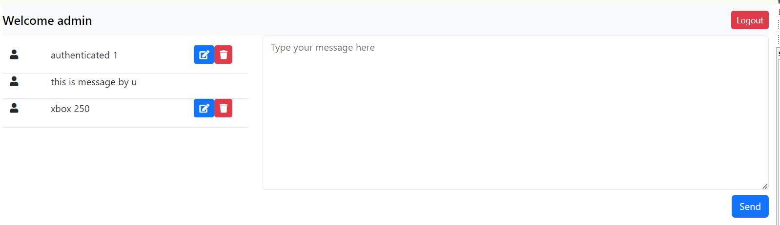
Bonus:Add the ability for users to edit or delete their messages.
By clicking on the edit and delete icons, users can edit and delete the messages that are posted by them
Users can not edit or delete other's posts.

Slide 20
Bonus:Deploy the application to a cloud service.
Using Docker, containerized the apps.
Using below commands apps can be started in docker.
docker run -p 3000:3000 messaging-ui
docker run -p 5000:5000 messaging-resource-server

